Slide 1
Introduction to
Kubernetes and microservices

Slide 2
Kubernetes
Kubernetes is a platform for hosting Docker containers in a clustered environment with multiple Docker hosts
Provides container grouping, load balancing, auto-healing, scaling features
Project was started by Google
Contributors == Google, CodeOS, Redhat, Mesosphere, Microsoft, HP, IBM, VMWare, Pivotal, SaltStack, etc

Slide 3
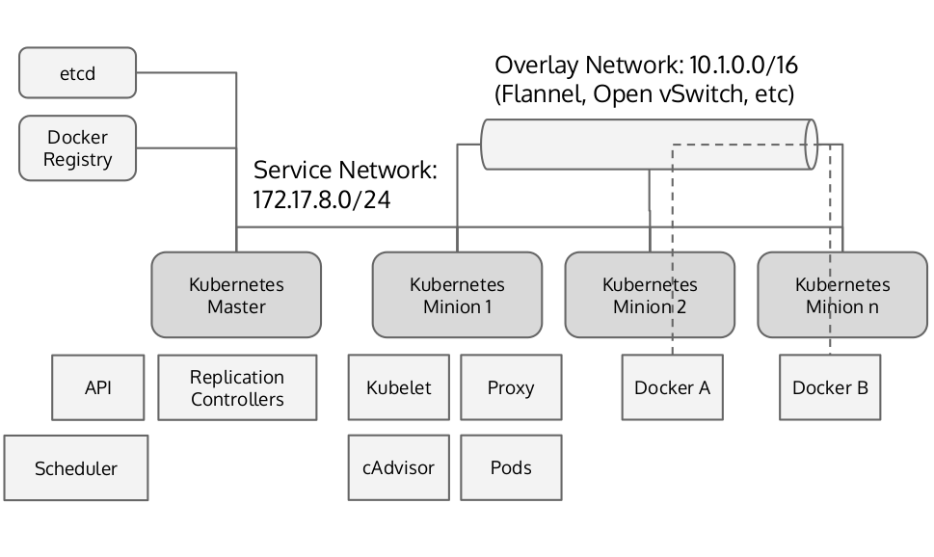
Kubernetes Architecture

Slide 4
Terminology
Clusters
Pods
Replication controllers/Replica set
Services
Labels
Namespaces
Configmaps
Secrets
Daemonsets
Deployments

Slide 5
Clusters
A set of resources where pods are deployed managed and scaled
Network
Compute
storage

Slide 6
Pods
Pods are colocated groups of application containers
Smallest unit in K8S
Can contain multiple containers
Only run standalone pods for jobs
Long running applications should be managed by replication controllers
Docker images of one pod run on one machine
Single IP per pod

Slide 7
Replication controllers/Replica set
Replication controllers ensure that a specific number of pods are running on the cluster
Based on a template which can contain multiple pods
Can use labels for grouping
Replica sets are the Next Gen replication controller
Only difference is the ability to select based on set rather than single label

Slide 8
Services
Services deliver cluster wide service discovery and basic load balancing
Provide persistent name or address for pods
Can use a single or multiple sets of labels

Slide 9
Labels
Used to organize and select group of objects such as pods based on Key/Value pairs

Slide 10
Namespaces
Kubernetes supports multiple virtual clusters backed by the same physical cluster. These virtual clusters are called namespaces.
Used to divide cluster resources between multiple uses
For example: dev, staging, production etc..
Not to be confused with labels

Slide 11
Configmaps
Configmaps are a way to decouple data from image content
Used to keep kubernetes data decoupled from images
Can be used to store simple information
But can even contain full configiration or json files

Slide 12
Secrets
objects of type secret are intended to hold sensitive information
Passwords
oauth tokens
Ssh keys

Slide 13
Deployments
A Deployment provides declarative updates for Pods and Replica Sets
Create a Deployment to bring up a Replica Set and Pods
check the status of a Deployment to see if it succeeds or not.
Later, update that Deployment to recreate the Pods (for example, to use a new image)
Rollback to an earlier Deployment revision if the current Deployment isn’t stable
Pause and resume a Deployment

Slide 14
Control plane components
Etcd
Api server
Scheduler
Controller manager

Slide 15
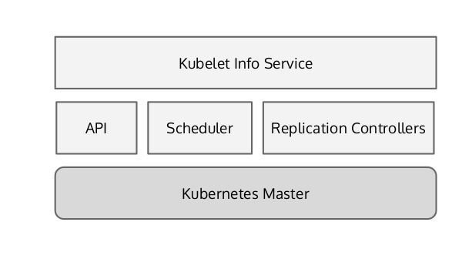
Kubernetes master - Control plane

Slide 16
etcd
Etcd is a consistent value store
Used in K8s for shared configuration and service discovery
Focuses on being simple, fast and reliable
Uses Raft consensus algorithm which allows fault tolerance and HA
All persistent cluster state is stored in etcd

Slide 17
Api server
Is responsible for serving the Kubernetes API and proxying cluster components such as the web UI
Exposes a REST interface which allows creating pods, services and updating the corresponding objects in etcd
The only component that talks directly to etcd

Slide 18
Scheduler
Watches the apiserver for unscheduled pods and schedules them onto healthy nodes based on resource requirements

Slide 19
Controller manager
Contains multiple cluster level functions
Manages service end-points (endpoint controller)
Node lifecycle managment (node controller)
Replication controller manager

Slide 20
Kubernetes node components
Docker
Kubelet
proxy

Slide 21
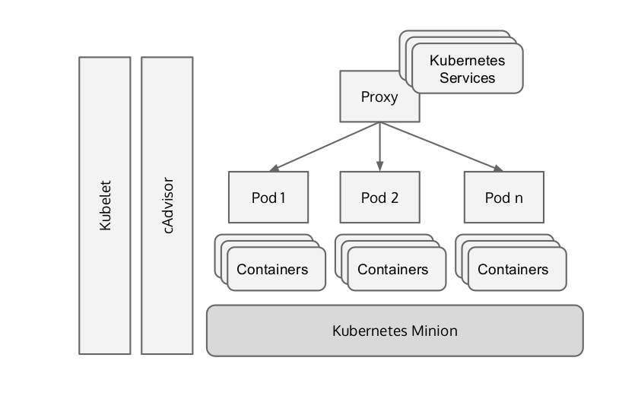
Kubernetes node (worker node)

Slide 22
Docker
Every node should contain the docker runtime engine
Handles downloading and running containers
Controller locally via API by the kubelet

Slide 23
Kubelet
Manages the node and is responsible for
Node registration
Pod management
Resource utilization report for scheduling purposes
Health status for pods running on node

Slide 24
kube-proxy
Every runs a kube-proxy daemon
In charge of simple TCP and UDP stream forwarding to services managed in kubernetes (sually using IPtables)
Manages docker links
Optionally allows dns management using an addon

Slide 25
Kubernetes resource declaration
Pods
Replication controller/Replica set
Services
Configmaps
Secrets
Deployments

Slide 26
Pod resource declaration
{
"kind": "Pod",
"apiVersion": "v1",
"metadata": {
"name": "my-cool-nginx",
"labels": {
"app": "mynginx"
}
},
"spec": {
"containers": [
{
"name": "my-cool-nginx",
"image": "omrisiri/nginx-hello",
"ports": [
{
"containerPort": 8080,
"protocol": "TCP"
}
]
}
]
}
}
$ kubectl create -f ./single-pod.json
Save it as single-pod.json

Slide 27
Replication controller declaration
{
"kind": "ReplicationController",
"apiVersion": "v1",
"metadata": {
"name": "nginx-controller"
},
"spec": {
"replicas": 2,
"selector": {
"app": "nginx"
},
"template": {
"metadata": {
"labels": {
"app": "nginx"
}
},
"spec": {
"volumes": null,
"containers": [
{
"name": "nginx",
"image": "omrisiri/nginx-hello",
"ports": [
{
"containerPort": 8080,
"protocol": "TCP"
}
],
"imagePullPolicy": "IfNotPresent"
}
],
"restartPolicy": "Always",
"dnsPolicy": "ClusterFirst"
}
}
}
}
$ kubectl create -f ./single-rc.json

Slide 28
Replication set declaration
apiVersion: extensions/v1beta1
kind: ReplicaSet
metadata:
name: frontend
spec:
replicas: 3
selector:
matchLabels:
tier: frontend
matchExpressions:
- {key: tier, operator: In, values: [frontend]}
template:
metadata:
labels:
app: guestbook
tier: frontend
spec:
containers:
- name: php-redis
image: gcr.io/google_samples/gb-frontend:v3
resources:
requests:
cpu: 100m
memory: 100Mi
ports:
- containerPort: 80

Slide 29
Service declaration
{
"kind": "Service",
"apiVersion": "v1",
"metadata": {
"name": "test-service"
},
"spec": {
"selector": {
"app": "nginx"
},
"ports": [
{
"protocol": "TCP",
"port": 80,
"targetPort": 8080
}
]
}
}
$ kubectl create -f ./single-service.json

Slide 30
Configmap declaration
kind: ConfigMap
apiVersion: v1
metadata:
creationTimestamp: 2016-02-18T19:14:38Z
name: example-config
namespace: default
data:
example.property.1: hello
example.property.2: world
example.property.file: |-
property.1=value-1
property.2=value-2
property.3=value-3
$ kubectl create configmap my-config --from-file=configfile.yaml

Slide 31
Secrets declaration
apiVersion: v1
kind: Secret
metadata:
name: test-secret
data:
data-1: dmFsdWUtMQ0K
data-2: dmFsdWUtMg0KDQo=
$ kubectl create -f secret.yaml

Slide 32
Deployment declaration
apiVersion: extensions/v1beta1
kind: Deployment
metadata:
name: nginx-deployment
spec:
replicas: 3
template:
metadata:
labels:
app: nginx
spec:
containers:
- name: nginx
image: nginx:1.7.9
ports:
- containerPort: 80
$ kubectl create -f nginx-deployment.yaml

Slide 33
Example time
Now we’ll show an example of deploying an nginx application using deployment
Rolling back and removing

Slide 34
The Kubectl Command
The kubectl command is used to manage all kubernetes functions
Creating new resources
Nodes
Pods
Services
Replication controller
Increasing replication size
Deployments

Slide 35
Kubectl commands - creating resources
# Create a pod using the data in pod.json.
kubectl create -f ./pod.json
# Create a pod based on the JSON passed into stdin.
cat pod.json | kubectl create -f -

Slide 36
Kubectl commands - Nodes and cluster info
#Get the state of your cluster
$ kubectl cluster-info
#Get all the nodes of your cluster
$ kubectl get nodes -o wide

Slide 37
Kubectl commands - pods
#Get info about the pods of your cluster
$ kubectl get pods -o wide
#Get the IP of a Pod
$ kubectl get pod <NAME_OF_POD> -template={{.status.podIP}}
#Delete a Pod
$ kubectl delete pod NAME

Slide 38
Kubectl commands - replication controller
#Get info about the replication controllers of your cluster
$ kubectl get rc -o wide

Slide 39
Kubectl commands - services
#Get info about the services of your cluster
$ kubectl get services
#Get full config info about a Service
$ kubectl get service <NAME_OF_SERVICE> -o json
#Delete a Service
$ kubectl delete service NAME_OF_THE_SERVICE

Slide 40
Deploying Kubernetes
Provision cluster nodes
Configure kubernetes compatible network
Deploy kubernetes services
Client tools

Slide 41
Consistent data store - etcd
Etcd is a distributed, consistent key-value store
Secure - optional SSL client cert authentication
Fast - Benchmarked at 1000s of writes per second
Reliable - properly distributes using the raft consensus algorithm

